Slide 1
Course
AWS Cloud Practitioner
MaxCloud

Slide 2
12
Class
VPC

Slide 3
Amazon VPC
Amazon Virtual Private Cloud (Amazon VPC) gives you full control over your virtual networking environment, including resource placement, connectivity, and security. Get started by setting up your VPC in the AWS service console.
Next, add resources to it such as Amazon Elastic Compute Cloud (EC2) and Amazon Relational Database Service (RDS) instances.
Finally, define how your VPCs communicate with each other across accounts, Availability Zones, or AWS Regions. In the example below, network traffic is being shared between two VPCs within each Region.

Slide 4
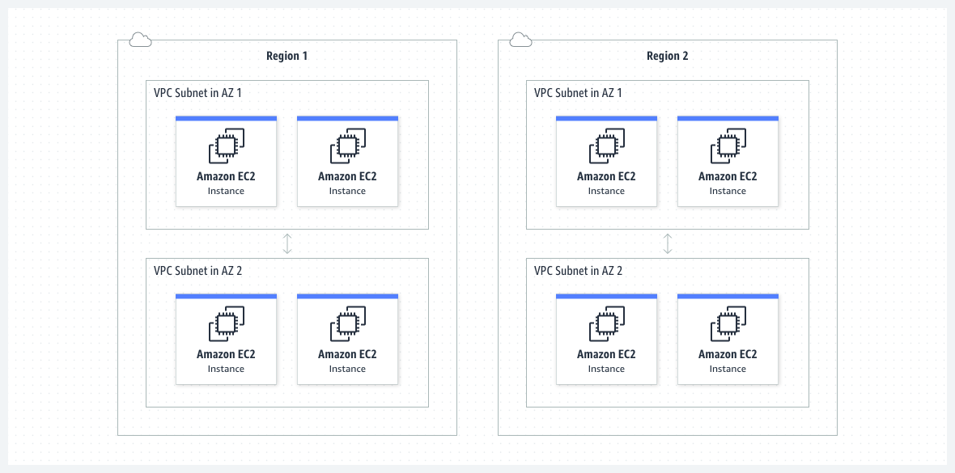
Amazon VPC

Slide 5
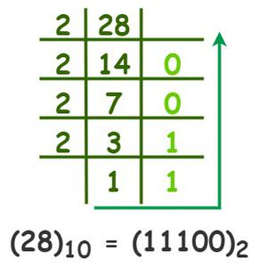
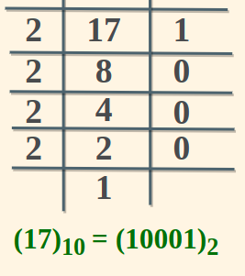
Decimal to Binary

Slide 6
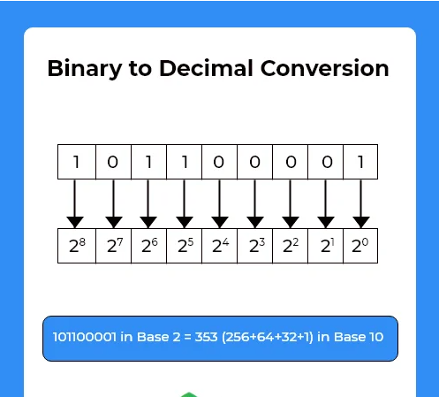
Binary to decimal

Slide 7
IP Subnetting 1
Example 1:
IP Address : 192.168.5.85
Subnet Mask : 255.255.255.0
IP/Subnet Mask : 192.168.5.85/24
Bits:
IP Address : 11000000. 10101000.00000101.01010101
Subnet Mask : 11111111. 11111111. 11111111.00000000
Min IP: 11000000. 10101000.00000101.00000000 (255.255.255.0)
Max IP: 11000000. 10101000.00000101.11111111 (255.255.255.255)

Slide 8
IP Subnetting 2
Example 1:
IP Address : 10.128.240.50
Subnet Mask : 255.255.255.252
IP/Subnet Mask : 10.128.240.50/29
Bits:
IP Address : 00001010.10000000.11110000.00110010
Subnet Mask : 11111111.11111111.11111111.11111100
Min IP: 11000000. 10101000.00000101. 00110000 (255.255.255. 48)
Max IP: 11000000. 10101000.00000101. 00110011 (255.255.255.54)

Slide 9
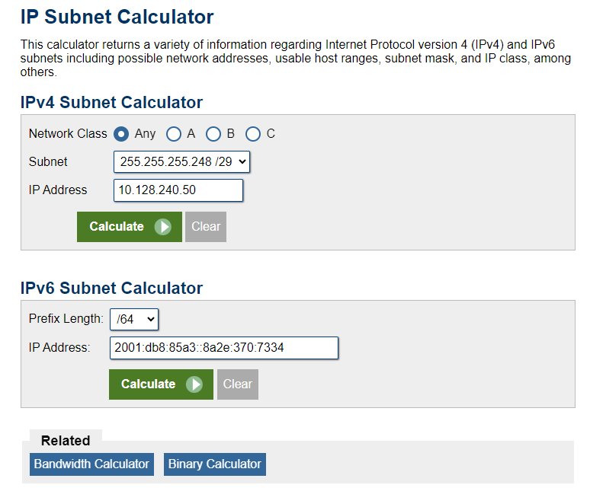
Online tools
https://www.calculator.net/ip-subnet-calculator.html

Slide 10
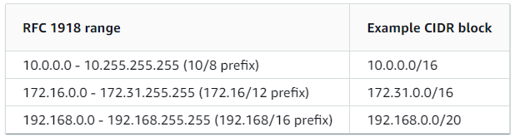
IPv4 VPC CIDR blocks

Slide 11
Diseño AWS VPC
Amazon VPC:
us-west-2 10.0.0.0/16 (Network)
us-west-2a 10.0.0.0/24 (Subnet)
us-west-2b 10.0.1.0/24 (Subnet)
us-west-2c 10.0.2.0/24 (Subnet)

Slide 12
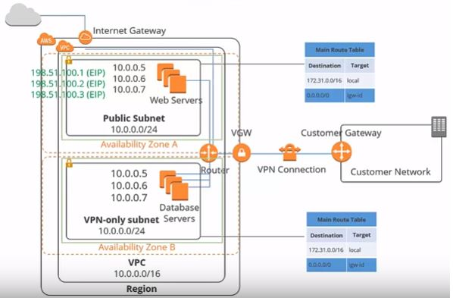

Slide 13
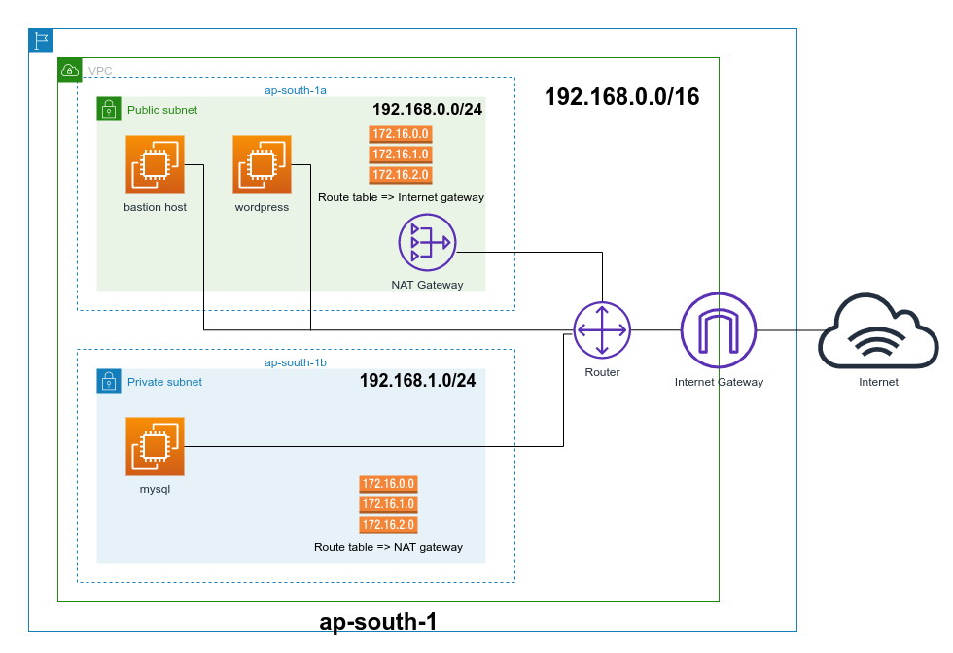
Internet Gateway

Slide 14
Private vs Public Subnet

Slide 15
Route Table

Slide 16
Nat Gateway

Slide 17
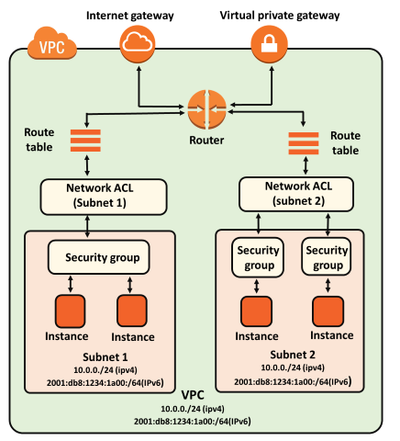
SG VS NACL

Slide 18
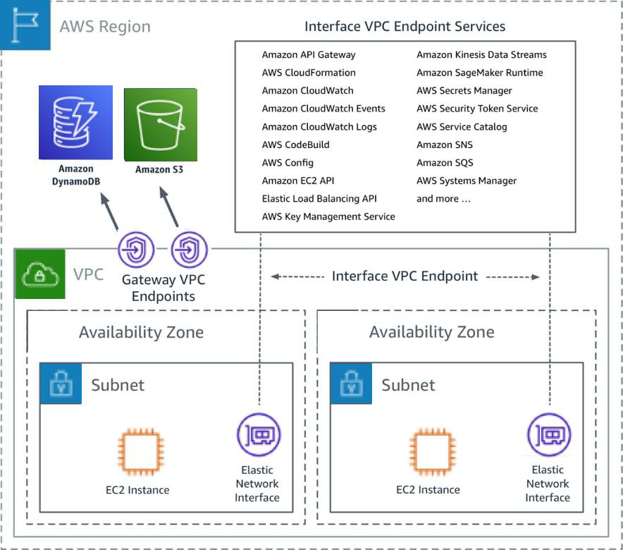
Gateway and interface endpoint

Slide 19
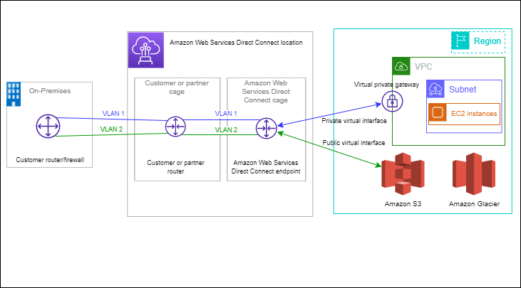
AWS Direct Connect

Slide 20
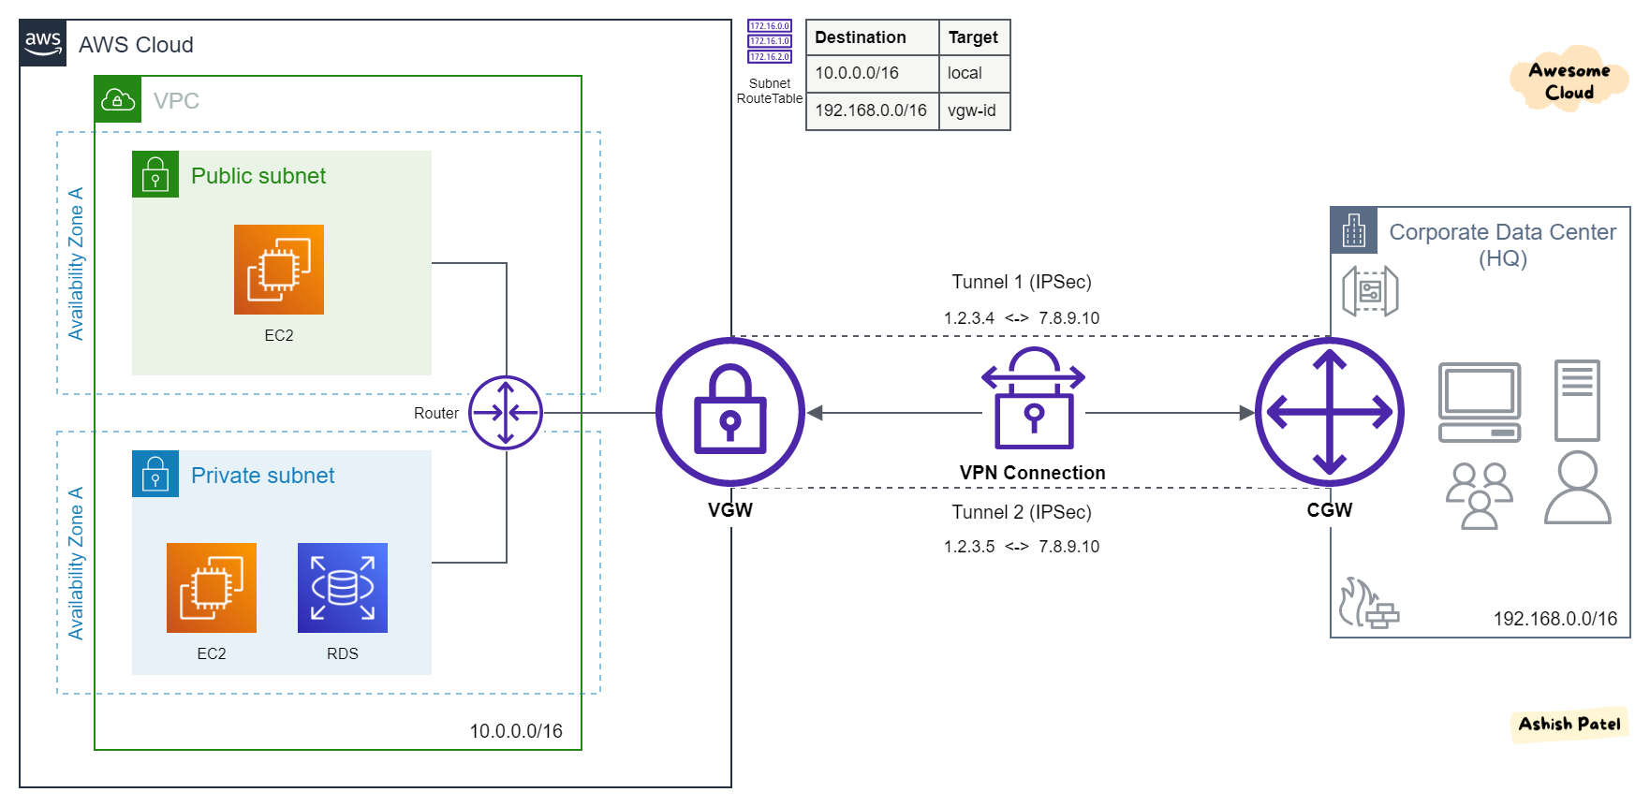
VPN Conection

Slide 21
Muchas Gracias

